Slide 1
Module 9: Implementing through visual designs

Slide 2
Control variations and grouping
Display user data

Slide 3
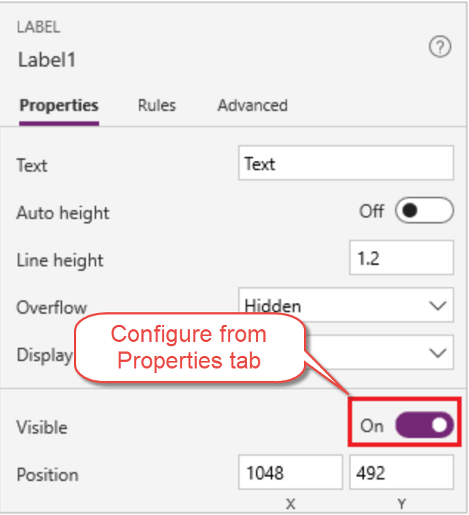
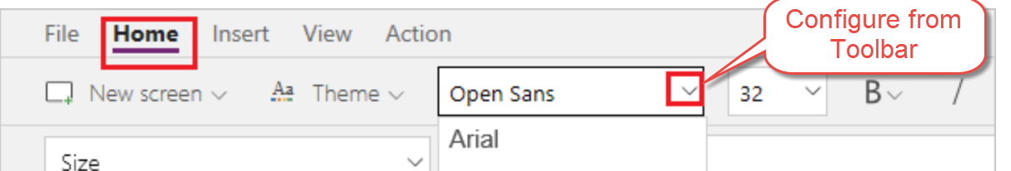
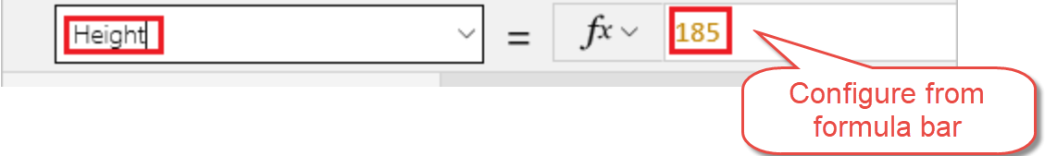
Control variations
Notes:
Mention:
Add a variety of UI elements to your canvas app, and configure aspects of their appearance and behavior directly, from the toolbar, in the Properties tab, or in the formula bar. These UI elements are called controls, and the aspects that you configure are called properties.
Actions you can take:
Rename control
Delete control
Reorder screens
Move and resize controls
Change the text of a label or a button
Use Toolbar, Properties Tab, or Formula bar to configure a control
When configuring a control common properties you can affect:
Color and border – Configure the color and border of a control that can change as a user interacts with it.
Core – Configure whether the user can see and interact with a control.
Image – Configure what image is shown and how it fills the control.
Size and location – Configure how big a control (or an element of a control) is and where it is in relation to the screen it's on.
Text – Configure how text appears in controls, such as font characteristics, alignment, line height.
** See the following for more info https://docs.microsoft.com/en-us/powerapps/maker/canvas-apps/reference-properties
https://docs.microsoft.com/en-us/powerapps/maker/canvas-apps/add-configure-controls

Slide 4
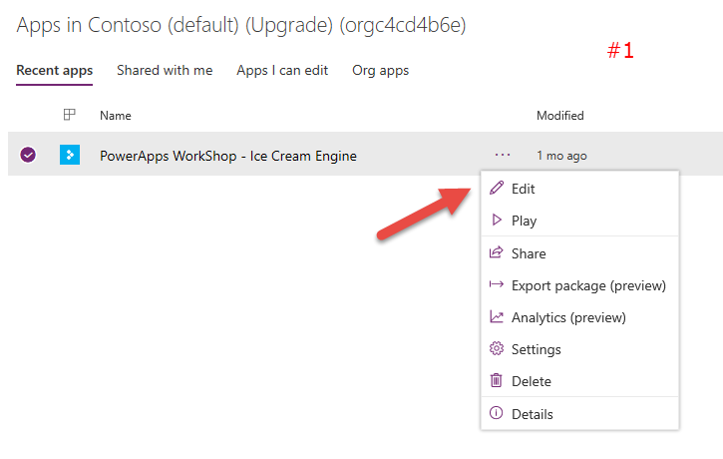
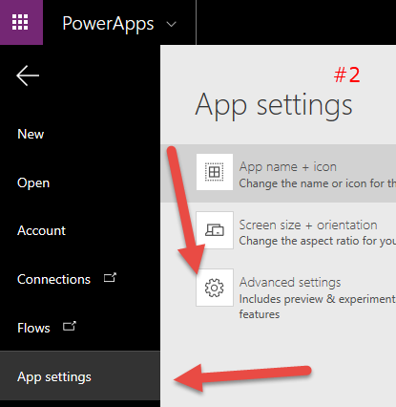
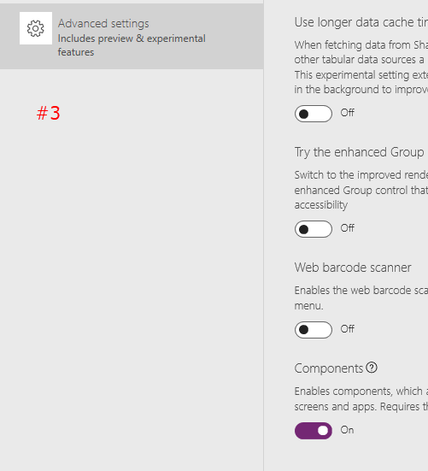
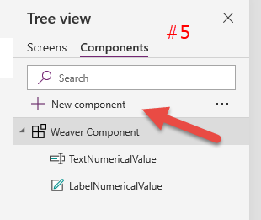
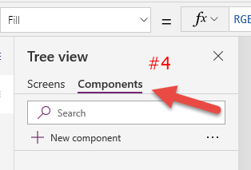
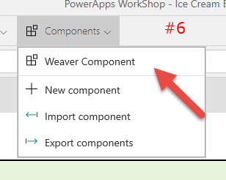
Components “Reusable grouped controls”
Notes:
Mention:
Canvas components make it easier to build reusable controls, such as navigation menus or set of buttons/text boxes or labels by grouping controls together in a reusable instance. The behavior makes it easy to reuse them as building blocks inside the app
Currently an experimental feature (As of 3/6/2019)
Developer can choose properties to represent there ‘Component’
Each instance has it’s own version of all properties
Discuss:
NOTE: This is experimental at this point 4/5/2019
Open the PowerApps Studio (Select App and Edit)
Go to File > App settings > Advanced settings.
Turn on “Components” in Experimental features.
In the Tree View, select “Components” and you will land on a square canvas.
Click New Component, then Add controls that you want to group
Click back to screens on right side select ‘Components’ and then select your component and added it to screen
https://powerapps.microsoft.com/en-us/blog/components-available-in-preview/

Slide 5
Add Compare Screens, Add/Remove Gallery Controls, and Test the App Lab 4.1 – Exercise 1-2
Objectives
After completing this lab, you will be able to:
Add Compare Screen
Remove and add controls to the gallery
Highlight selected device
Add icon to navigate
Test the app
Scenario
The organization wishes to build apps using the Power Apps platform to take advantage of No Code/Low Code application development in the cloud. As part of this effort, you are required to add compare screens, add/remove gallery controls, manipulate the navigation, and test the functionality of your app.
Notes:
See lab file M9.1_PowerApps_PowerUser_ImplementingthruVisualDesigns.docx and complete tasks 1 - 2

Slide 6
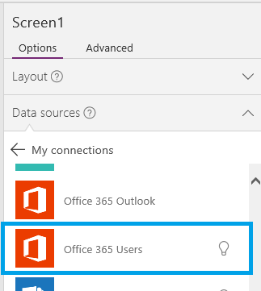
Display user data - Configure connection
Sign up for Power Apps
Start with template
Connect to Data – New Connection
Select Office 365 Users
Notes:
Sign up for PowerApps
Go to Power Apps site to sign up or see what kind of license you are assigned
Start with Template
From the Home tab go to Start from Blank and select Make this App
Connect to Data – New Connection
Once you click on New Connection you will be presented with a list of Connection Types
Select Office 365 Users
Select Connect, when prompted enter your credentials.
The Office 365 Users connection has been created and added to your app. Now, it's ready to be used.
https://docs.microsoft.com/en-us/powerapps/maker/canvas-apps/add-data-connection
https://docs.microsoft.com/en-us/powerapps/maker/canvas-apps/connections/connection-office365-users
https://docs.microsoft.com/en-us/connectors/office365users/

Slide 7
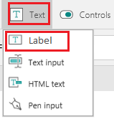
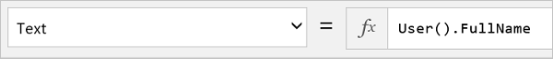
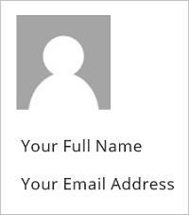
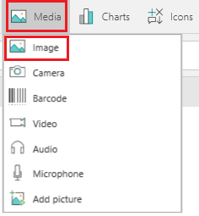
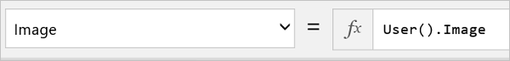
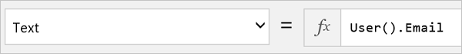
Display user data – Current user
Notes:
Discuss:
Does not require O365Users Connector
On the Insert tab, click or tap Media, and then click or tap Image.
Set the Image property to this formula: User().Image
On the Insert tab, click or tap Text, and then click or tap Label:
Set the Text property to this formula: User().FullName
Add another label and set its Text property to this formula: User().Email
User() Record of all information for the current PowerApps user. { FullName: "John Doe", Email: "john.doe@contoso.com", Image: "blob:1234...5678" }
User().Email The email address of the current PowerApps user. "john.doe@contoso.com"
User().FullName The full name of the current PowerApps user. "John Doe"
User().Image The image URL for the current PowerApps user. Set the Image property of the Image control to this value to display the image in the app.
https://docs.microsoft.com/en-us/powerapps/maker/canvas-apps/functions/function-user

Slide 8
Display user data – Users, managers, and direct reports
Office365Users.MyProfile()
Office365Users.UserProfile(<UPN> or Email ID)
Office365Users.Manager(<UPN> or Email ID)
Office365Users.DirectReports(<UPN> or Email ID)
Available properties: Department, DisplayName, GivenName , Id, JobTitle, Mail, MailNickname, Surname, TelephoneNumber, UserPrincipalName, and AccountEnabled
Notes:
Mention:
There are V2 of these functions which provide more properties
Discuss:
TextBox to get UPN or Email ID **You can use a formula to pull from another location
https://docs.microsoft.com/en-us/powerapps/maker/canvas-apps/connections/connection-office365-users
You can add the following to a label:
Office365Users.MyProfile(): DisplayName for current user
Office365Users.MyProfile().DisplayName
Office365Users.UserProfile(<UPN> or Email ID): DisplayName of jsmith@contoso.com
Office365Users.UserProfile(jsmith@contoso.com).DisplayName
Office365Users.Manager(<UPN> or Email ID): DisplayName for the Manager of jsmith@contoso.com
Office365Users.Manager(jsmith@contoso.com).DisplayName
Office365Users.DirectReports(<UPN> or Email ID): DisplayName of all direct reports for jsmith@contoso.com
Office365Users.DirectReports(jsmith@contoso.com).DisplayName

Slide 9
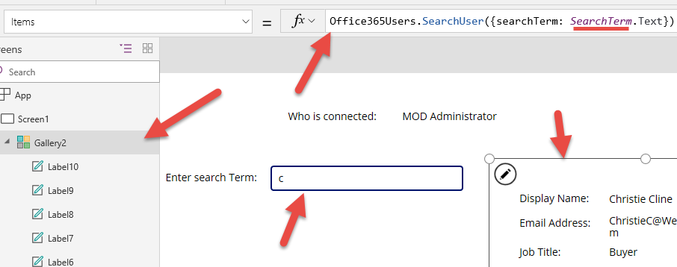
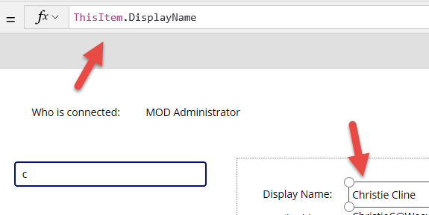
Display user data – Search for users
Note: Functions are case sensitive ‘searchTerm’ must have upper case “T”.
Notes:
Mention:
Search string. Applies to: display name, given name, surname, mail, mail nickname, and user principal name
Function are case sensitive in PowerApps Studio
Discuss:
Add Text Box and Rename to SearchTerm enter a value like ‘c’
Add a Gallery to screen set Items property to ‘Office365Users.SearchUser({searchTerm: SearchTerm.Text})’
Design Gallery to include Labels with meaning Text = ThisItem.DisplayName
Available properties Department, DisplayName, GivenName , Id, JobTitle, Mail, MailNickname, Surname, TelephoneNumber, UserPrincipalName, and AccountEnabled

Slide 10
Display user data
Add functionality to app to show current user and manager in Power Apps

Slide 11
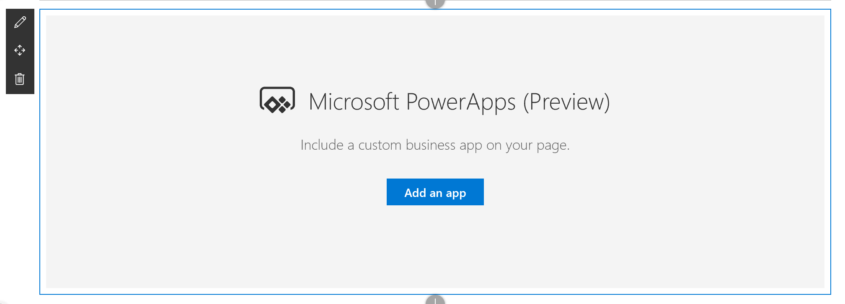
Adding Power Apps to SharePoint via web part
Notes:
Mention:
Before web part users would use iFrame and embed Power Apps app in page (See this for more info https://powerapps.microsoft.com/en-us/blog/embed-powerapps-on-sharepoint-pages/)
Only works for Modern pages
Adding the app on a page does not automatically give users permissions to use the app.
Power Apps are designed to work best with fixed sizes.
The Power Apps (preview) web part for SharePoint Online does not yet support screen readers or keyboard navigation.
Discuss:
Hover your mouse above or below an existing web part click , then select the Power Apps web part.
Click Add an app button
In the property pane on the right, enter the Power Apps web link or app ID in the App web link or ID box.
If the default size of the app is too small or doesn’t fit the page, then resize the app by dragging the resize button on the bottom right of the web part.

Slide 12
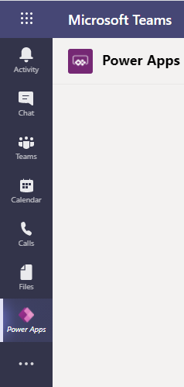
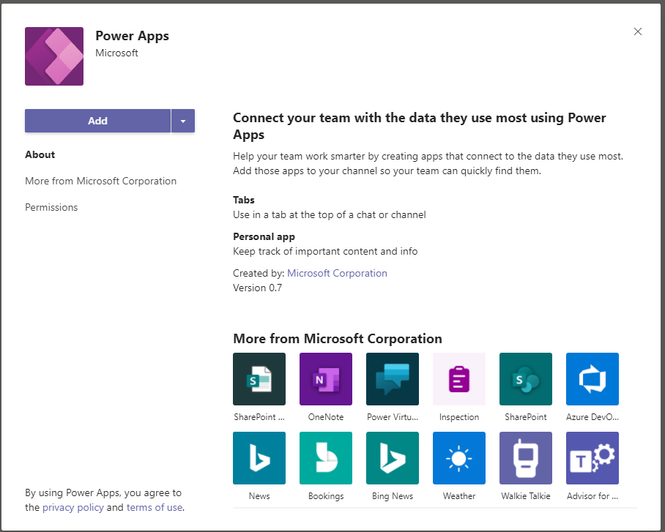
Integrating Power Apps and Teams (Preview)
Add to Teams like any other app
Create apps to access Project Oakland database, SharePoint list, or other repositories.
Add as a Tab to help find them
Notes:
Discuss
Currently canvas app only
Connectors are still Premium/Standard and require appropriate Power Apps license
Apps are stored in Project Oakland environment
Creation of app does not automatically add as tab
Mention
Currently in Preview

Slide 13
Design gallery and navigation Lab 4.1 – Tasks 3-6
Objectives
After completing this lab, you will be able to:
Add Compare Screen
Remove and add controls to the gallery
Highlight selected device
Add icon to navigate
Test the app
Scenario
The organization wishes to build apps using the Power Apps platform to take advantage of No Code/Low Code application development in the cloud. As part of this effort, you are required to add compare screens, add/remove gallery controls, manipulate the navigation, and test the functionality of your app.
Notes:
See lab file M9.1_PowerApps_PowerUser_ImplementingthruVisualDesigns.docx and complete tasks 3 - 6

Slide 14
What do we mean accessibility?
An accessible app will allow users with vision, hearing, and other impairments to successfully use the app or studio.

Slide 15
Who can we help?
User
Maker
Notes:
Maker is any developer/citizen developer who creates an App
User is any licensed person that consumes

Slide 16
How can we help?
Provide both Users and Makers access to Power Apps while using Assistive technologies
Makers need to follow guidelines as outlined by Microsoft
Makers need to follow WGAC guidelines from W3C
Makers should use Accessibility section of App Checker
Notes:
Assistive Technologies in Power Platform – Both developer tools and Power Apps use Assistive technologies like Screen Reader
Web Content Accessibility Guidelines (WCAG) - Developed through the W3C process in cooperation with individuals and organizations around the world, with a goal of providing a single shared standard for web content accessibility that meets the needs of individuals, organizations, and governments internationally
https://www.w3.org/WAI/standards-guidelines/wcag/
Microsoft Guidelines – Guidelines provide design solutions to help makers to design UI that works with Assistive technologies or provide a better experience for people with impairments
https://docs.microsoft.com/en-us/powerapps/maker/canvas-apps/accessible-apps
Makers should use Accessibility section of App Checker – Within App Checker in Power Apps Studio there is a section that will tell you what changes to make the app more accessible
https://docs.microsoft.com/en-us/powerapps/maker/canvas-apps/accessibility-checker

Slide 17
Microsoft Guidelines
Optimize Layout and Color
Provide Keyboard Support
Provide Screen Reader Support
Working with Multimedia
Working with Signatures
Notes:
Optimize Layout and Color
Provide a common sense and uncomplicated design
Microsoft Power Apps themes are designed to meet accessibility standards look to use them first
Ensure input elements are labeled on the screen. i.e.. AccessibilityLabel property defines what the screen reader will announce
When customizing colors, ensure the contrast of text:background is 4.5:1 or greater. Software tools that assist this process are readily available.
Ensure layout follows a logical flow when read top-bottom, left to right
Ensure App UI flow Left to Right and Top to Bottom
Provide Keyboard Support
Ensure the app can be used with the keyboard only if needed
Ensure the app can be navigated successfully with the screen reader enabled
Label, Image, Icon, Shape controls - if they represent interactive elements (ie.buttons) set TabIndex to 0; if they are decorative elements or text, set TabIndex to -1
Avoid setting tab index higher than zero
Provide Screen Reader Support
Recommended software combos
Windows: Microsoft Edge / Narrator
macOS: Safari / VoiceOver
Android: Power Apps app / Talkback
iOS: Power Apps app / VoiceOver
Ensure all input controls have the AccessibilityLabel property set
Ensure images set AccessibilityLabel to an appropriate description, except when a picture is there just for the decoration (i.e.. Company logo) and should not be read by the screen reader, in that case the AccessibilityLabel is empty or not set
Ensure if a picture or an icon is used as a button, then set TabIndex to 0 and AccessibilityLabel to the link description
Working with Multimedia
Ensure all videos are captioned and a transcript of all audio recordings is available to the user
Video control supports closed captions in WebVTT format via the ClosedCaptionsUrl property
Working with Signatures
If using PenInput have a Keyboard only method for users to sign i.e. TextInput control

Slide 18
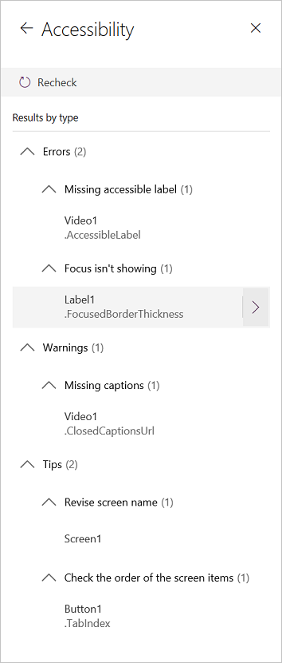
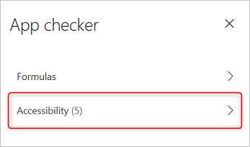
Using App checker for Accessibility
Finds potential accessibility issues but also explains why each might be a potential problem
Detects screen-reader and keyboard issues for you
Notes:
The Accessibility checker provides following classification
Errors identify issues that make the app difficult or impossible to use and understand for users who have a disability.
Warnings identify issues that make the app difficult to use or understand for most but not all users who have a disability.
Tips help you improve the experience of users who have a disability.

Slide 19
Connect data to your Canvas App Lab 4.2
Objectives
After completing this lab, you will be able to:
Connect SharePoint list as data source
Configure and add form
Submit Form
Test the app
Scenario
The organization wishes to build apps using the Power Apps platform to take advantage of No Code/Low Code application development in the cloud. As part of this effort, you are required to add new data source (SharePoint list), configure, add and submit form, add/remove gallery controls, manipulate the navigation, and test the functionality of your app.
Notes:
See lab file M4.1_PowerApps_PowerUser_ImplementingthruVisualDesigns.docx and complete all tasks

Slide 20
Control variations and grouping
Display user data
Add Power Apps to SharePoint via Power Apps web part

